Slide 1
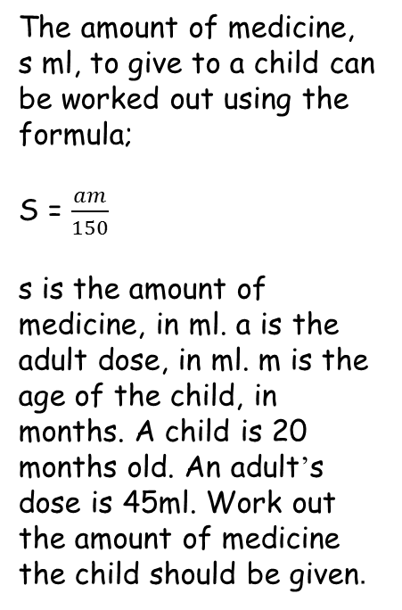
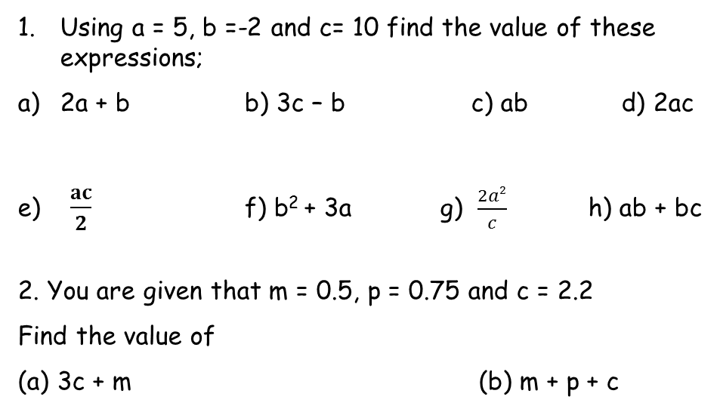
Literacy
Research
Memory
Write a definition for 2 of these;
Expression,Term, Formula, Substitution,
How many common formulae can you find that are used in maths, science or business?
Learn the formula for the area of a trapezium
Area = ½ (a + b) h
Skill Practice
Stretch!

