Slide 1
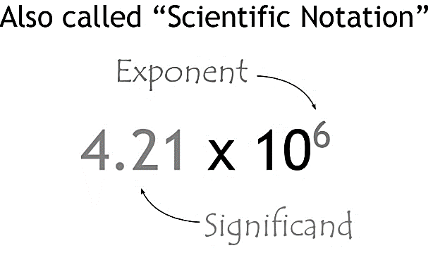
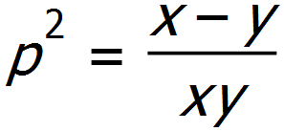
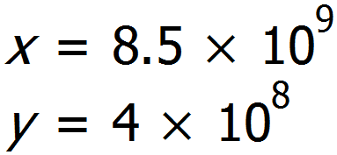
Mathswatch Clip 83
Corbett Maths Video 300
Write, using standard form, the distance in metres from:
Earth to the sun
Earth to Voyager 1
Earth to Proxima Centauri
The significand must be between one and ten.
A negative exponent is used for numbers between 0 and 1
A positive exponent is used for numbers bigger than 10.
Standard Form Homework
Convert these values into standard form:
2. Covert these numbers into decimal values:
3. Work out the answers in standard form:
Find the value of p if:
and
2. It takes light to travel 14 thousand million years to travel to the edge of the universe.
If the speed of light is
$9.46×{10}^{12}$km/year, how far is the edge of the universe?
$3×{10}^{3} ×$ $2×{10}^{4}$
$2.5×{10}^{4} ×$ $4×{10}^{2}$
$9×{10}^{6} ÷$ $3×{10}^{2}$
$1.8×{10}^{2} ÷$ $6×{10}^{5}$

Slide 2
Mathswatch Clip 83
Corbett Maths Video 300
Write, using standard form, the distance in metres from:
Earth to the sun
Earth to Voyager 1
Earth to Proxima Centauri
$$1.474 ×{10}^{11}$$
$$2.06 ×{10}^{13}$$
The significand must be between one and ten.
A negative exponent is used for numbers between 0 and 1
$$3.991 ×{10}^{16}$$
A positive exponent is used for numbers bigger than 10.
Standard Form Homework
Convert these values into standard form:
2. Covert these numbers into decimal values:
3. Work out the answers in standard form:
$$4.826×{10}^{2}$$
$$2×{10}^{3}$$
$$6.7×{10}^{4}$$
$$3×{10}^{−3}$$
Find the value of p if:
and
$$4.65×{10}^{−5}$$
$$1.007×{10}^{−2}$$
293000
$$4.8809353 ×{10}^{−5}$$
6000
0.007
4800
2. It takes light to travel 14 thousand million years to travel to the edge of the universe.
If the speed of light is
$9.46×{10}^{12}$km/year, how far is the edge of the universe?
0.0000856
400.2
$3×{10}^{3} ×$ $2×{10}^{4}$
$$6×{10}^{7}$$
$2.5×{10}^{4} ×$ $4×{10}^{2}$
$$1×{10}^{7}$$
$9×{10}^{6} ÷$ $3×{10}^{2}$
$$3×{10}^{4}$$
$1.8×{10}^{2} ÷$ $6×{10}^{5}$
$$3×{10}^{−4}$$
$1.3244×{10}^{23}$km

