Slide 1
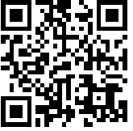
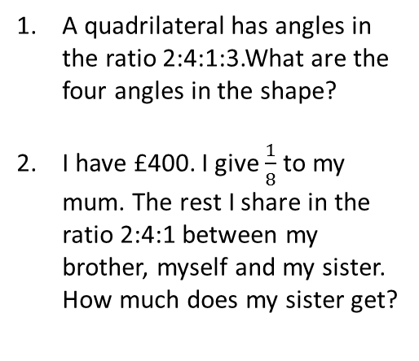
Key Words: Parts, Share, Ratio, Equivalent, Simplify
Mathswatch Clip 106
Corbett maths Video 270
Find, and evidence, at least 3 real life examples of ratios.
Task: Your friend missed our amazing lesson today. Write a text to them explain what we did and how to do it.
+ Add together the parts in the ratio
÷ Divide the amount by your answer
x Multiply your answer by each part of the ratio
Sharing into ratio homework
Share the following amounts into the given ratios:
Kate and Linda share 36 cakes in the ratio of 1:3
Calculate how many Linda gets.
A box of 56 chocolates contains dark, milk and white chocolates in the ratio 2:5:1. Gordon does not like milk chocolate. How many chocolates will he happily eat?
£48 into 1:3 90kg into 7:2 56m into 22:6
100ml into 3:17 72cm into 2:2:5 £150 into 15:5:30
A quadrilateral has angles in the ratio 2:4:1:3.What are the four angles in the shape?
I have £400. I give $\frac{1}{8}$ to my mum. The rest I share in the ratio 2:4:1 between my brother, myself and my sister. How much does my sister get?

Slide 2
Key Words: Parts, Share, Ratio, Equivalent, Simplify
Mathswatch Clip 106
Corbett maths Video 270
Find, and evidence, at least 3 real life examples of ratios.
Task: Your friend missed our amazing lesson today. Write a text to them explain what we did and how to do it.
+ Add together the parts in the ratio
÷ Divide the amount by your answer
x Multiply your answer by each part of the ratio
Sharing into ratio homework
Share the following amounts into the given ratios:
Kate and Linda share 36 cakes in the ratio of 1:3
Calculate how many Linda gets.
A box of 56 chocolates contains dark, milk and white chocolates in the ratio 2:5:1. Gordon does not like milk chocolate. How many chocolates will he happily eat?
£48 into 1:3 90kg into 7:2 56m into 22:6
100ml into 3:17 72cm into 2:2:5 £150 into 15:5:30
£12:£36 70kg:20kg 44m:12m
15ml:85ml 16cm:16cm:40cm £45:£15:£90
A quadrilateral has angles in the ratio 2:4:1:3.What are the four angles in the shape?
I have £400. I give $\frac{1}{8}$ to my mum. The rest I share in the ratio 2:4:1 between my brother, myself and my sister. How much does my sister get?
$$72°:144°:36°:108°$$
27 cakes
21 – 14 dark and 7 white
£50

