Slide 1
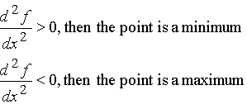
Literacy
Explain how you would determine if a stationary point is a maximum or minimum point.
Memory
STRETCH AND CHALLENGE
Research
Is there such thing as the third derivative and, if so, what does it represent?
The Second Derivative
SKILL

