Slide 1
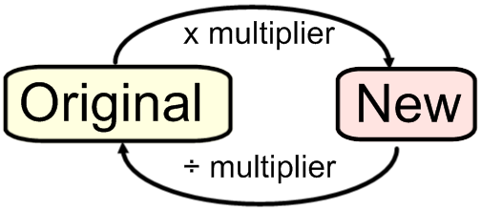
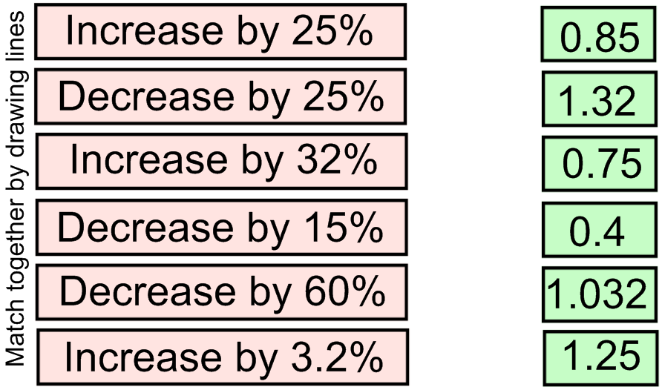
Literacy
Research
Memory
Un-jumble the following keywords
As a percentage, what is the current population growth rate of the UK?
Write this as a decimal multiplier.
rinse ace
race seed
eves err
creep agent
epic tree ad
Skill Practice
Stretch!
Task 1
Task 2
Use your multiplier from the research task to answer the following question.
A jacket is reduced by 40% in a sale to £36. What was its original price?
A car depreciates in value by 30% during its first year. Its value now is £8960. What was its original price?
A coat is reduced by 20% in a sale. If it was originally £85, how much is it now?
If a bed is reduced by 35% in a sale to £91.00, find the original price.
The bill in a restaurant comes to £92. A service charge of 15% is added. What is the new cost?
If a computer is reduced by 77% in a sale to £6.90, find the original price
Given that the UK population was 64.1 million in 2013, use your multiplier to predict what it would be in 2025.
www.mathedup.co.uk

