Slide 1
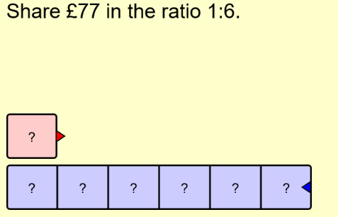
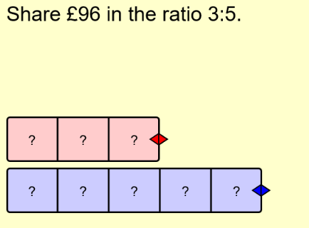
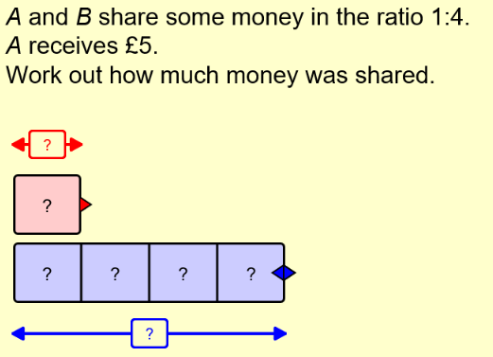
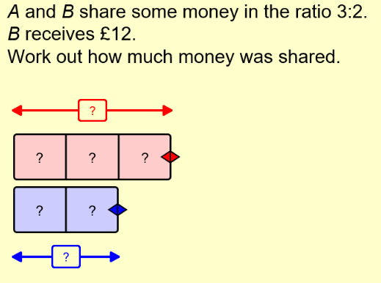
d
Literacy
Research
Memory
Fraction
Parts
Ratio
Proportion
Estimate what proportion
of the year you spend in
school.
Draw the correct Number of boxes for the ratio.
Check which information been given
Skill
Challenge

Slide 2
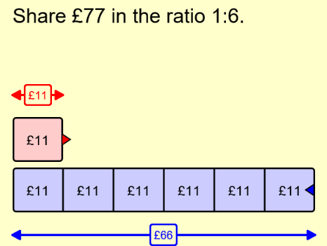
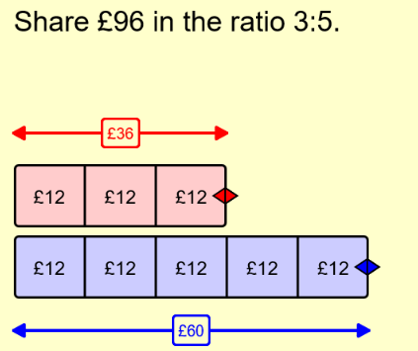
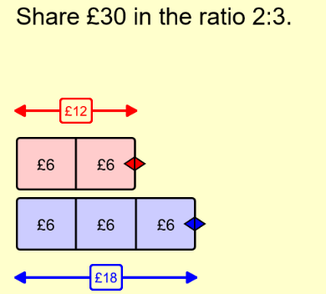
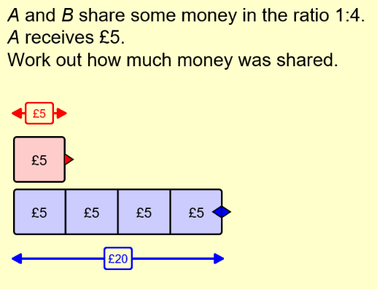
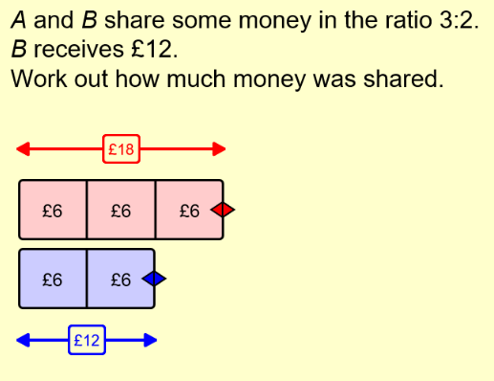
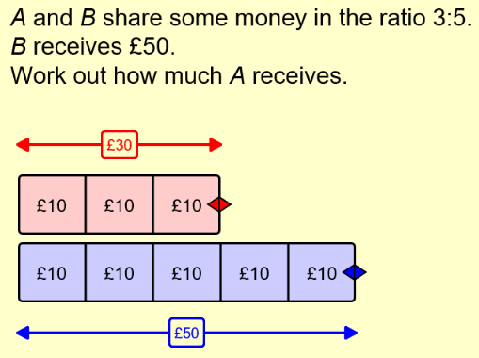
d
Literacy
Research
Memory
Fraction
Parts
Ratio
Proportion
Estimate what proportion
of the year you spend in
school.
Draw the correct Number of boxes for the ratio.
Check which information been given
Skill
Challenge

