Slide 1
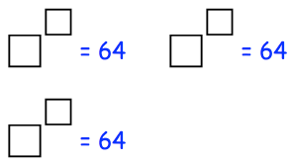
Literacy
Research
Memory
Write a definition for these words:
Integer
Indices
Find out about fractional
powers such as:
Learn the first 15 square numbers and the first 5 cube numbers
½ ¼
Explain your findings
Skill Practice
Stretch!
Work out the following without a calculator
a) ${\text{4}}^{2}$ b) ${\text{2}}^{5}$ c) ${\text{5}}^{3}$ d) ${\text{8}}^{3}$ e) ${\text{3}}^{4}$
TASK A. Fill in the boxes with possible integers
Work out the following without a calculator
a) ${\text{3}}^{2} −{\text{2}}^{2}$ b) ${\text{8}}^{2}$x ${\text{4}}^{2}$ c) ${\text{2}}^{5} ÷ {\text{4}}^{2}$
Work out the following without a calculator
a) ${\text{2}}^{4}$ + ${\text{10}}^{1}$ + ${\text{20}}^{2}$ b) $\sqrt{144}$ + $\sqrt{81}$
TASK B
Use the formula E=mc²
To work out E when; m=3 and c=300,000,000
Give your answer as a normal number and in standard form
Work out the missing number
${\text{7}}^{2}$ - $\sqrt{100}$ = ${___}^{2}$ + $\sqrt{9}$

