Slide 1
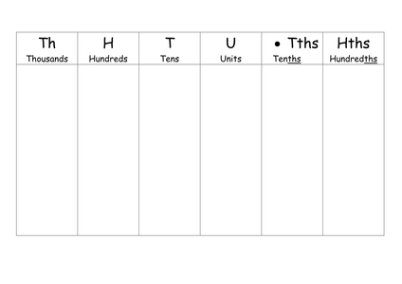
Literacy
Research
Memory
tens, thousands, hundreds, units, difference, total, figures, arrange, order,
ascending, descending
Find out the meaning of ascending and descending. Draw a picture to help you remember the meanings of these words.
Skill Practice
Stretch!
What is the 5 worth in each of these numbers:-
543 b) 5890 c) 6750 d) 2235
Write the number four thousand, three hundred and four in figures.
Create some new numbers using the values given:-
a) 3000 + 300 + 10 + 6 b) 5000 + 100 + 4 c) 7000 + 800 + 20 + 3
4) Write the number 8905 in words.
5) Arrange these numbers in ascending order:-
1367, 56, 2967, 1362, 2356
5300, 560, 5245, 56, 524
800, 8012, 80, 801,
6) Arrange these numbers in descending order:-
a) 287, 87, 8732, 732, 378
b) 42, 4230, 230, 4530, 45
c) 97, 79, 970, 9797, 979
Write the number twenty thousand, one hundred and seventy eight.
What is the 8 worth in 78012?
What is the 3 worth in 245.34?
Add 1020 to 820
What is the difference between 780 and 680?
Four friends finished a game of scrabble. The scores were as follows:-
Olivia-one hundred and six
Daniel-eighty nine
Emily-two hundred and three
Jack- ninety nine
a) What is the total score of all four players? Show all of your working out. Write your answer in words.
b) What do you need to add to your answer to make 1000?

