Slide 1
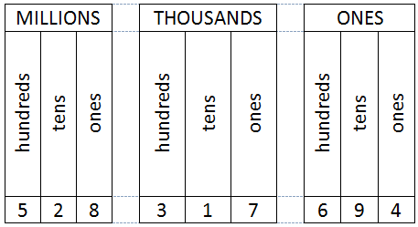
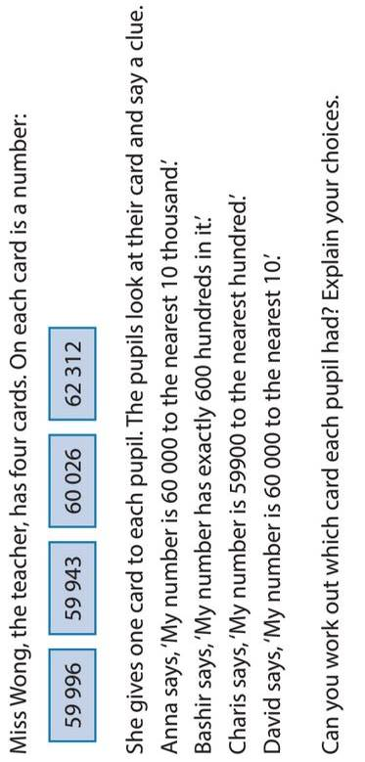
Vocabulary
Research
Memory
Place value, hundred, thousand, million, tenths, hundredths, approximately positive, negative, integer, decimals
Find out what the word integer means & write a definition.
Skill Practice
Stretch!
Ordering, rounding & valuing
QS4
1) Order the following numbers 35,408 38,407 35,406 38,333 29,999
2 & 3) Look at this number 234,852
2a) round to the nearest 1,000 2b) round to the nearest 100
3a) Write the digit that is in the hundreds place
3b) Write the digit that is in the thousands place
QS5
1) Order the following numbers 345,408 129,999 354,407 348,333 355,406 2 & 3) Look at this number 253,852
2a) round to the nearest 10,000 2b) round to the nearest 100,000
3a) Write the digit that is in the thousands place
3b) Write the digit that is in the hundred thousands place
QS6
Order the following numbers
4,345,408 4,129,999 4,354,407 4,348,333 4,355,406
2 & 3) Look at this number 2,653,852.42
2a) round to the nearest 100,000 2b) round to the nearest 10,000
3a) Write the digit that is in the hundred thousands place
3b) Write the digit that is in the hundredths place

