Slide 1
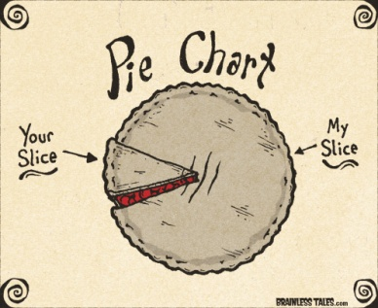
Title:- Pie Charts
Set on_____________
Due on _________________
Literacy
Research
Memory
In your book describe pie charts using the following words
Sector
Degrees
Frequency
Compare
Who invented and pie charts and when, and where they are used in real life.
Write a method to help you remember how to
draw a pie
interpret a pie chart
Skill practice
Challenge
Team A played 52 games and team B played 160 games.
Who won the most games ?
By how many games did they win by?
40 students study a language. Work out the size of each angles if this information is represented in a pie chart.
French – 16 students, Spanish 12 students, German 5 students, Italian 7 students.
The favourite cakes of some teachers is shown in the pie chart. 60 preferred chocolate.
How many teachers are there in total?
How many preferred fruit cake

