Slide 1
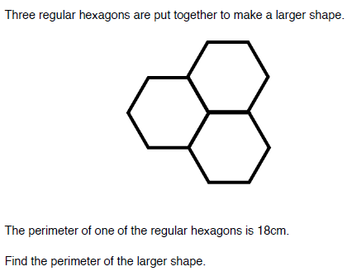
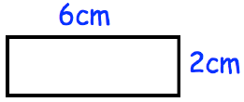
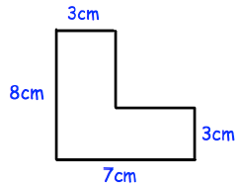
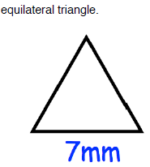
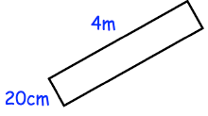
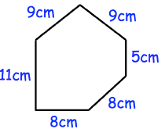
Stretch
Memory
Literacy
Find three Maths words in the wordsearch below
A | D | D | S | S
R | P | R | E | H
E | L | B | M | A
A | U | O | I | P
C | S | A | T | E
1.) ………………………..
2.) ………………………..
3.) ………………………….
Skill Practice
Find the perimeter of the shapes in Q1 to Q5
1)
4)
5)
3)
2)
6)
In a rectangle, the length is 3 times the width.
The perimeter is 48cm.
Work out the width and length.

