Slide 1
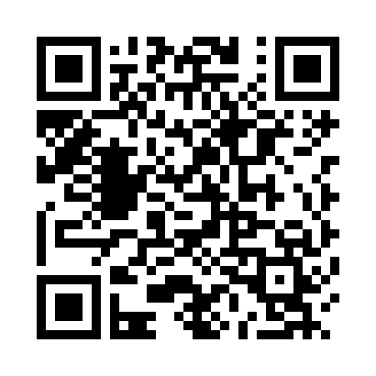
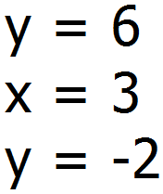
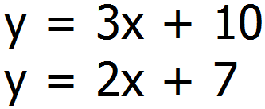
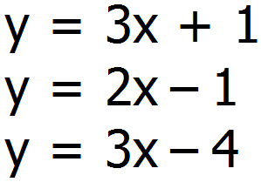
Mathswatch Clip 96
Corbett Maths Video 186
Find the definitions of these key words:
Find out who Descartes is and why he is a remembered mathematician.
Give me 5 bullet points summing up what you find out.
Linear
Parallel
Perpendicular
Intercept
Gradient
Quadratic
Things to remember:
Work out a table of values
Use x values -4 to 4
Use a pencil and ruler to draw your graph.
Label your graph
Drawing Graphs of Linear Equations
For these questions use -10 to 10 for both the x and y axis.
Q1 Draw these three lines on the same graph
Q1 By using a graph, find where the following two lines cross.
Find the coordinates where these three lines cross.
Q2 Draw these three lines on the same graph
Q2 Draw the line
Draw a line that is parallel to this and give the equation of that line.
Find the coordinates where these three lines cross.
Q3 Draw this line on a separate graph

Slide 2
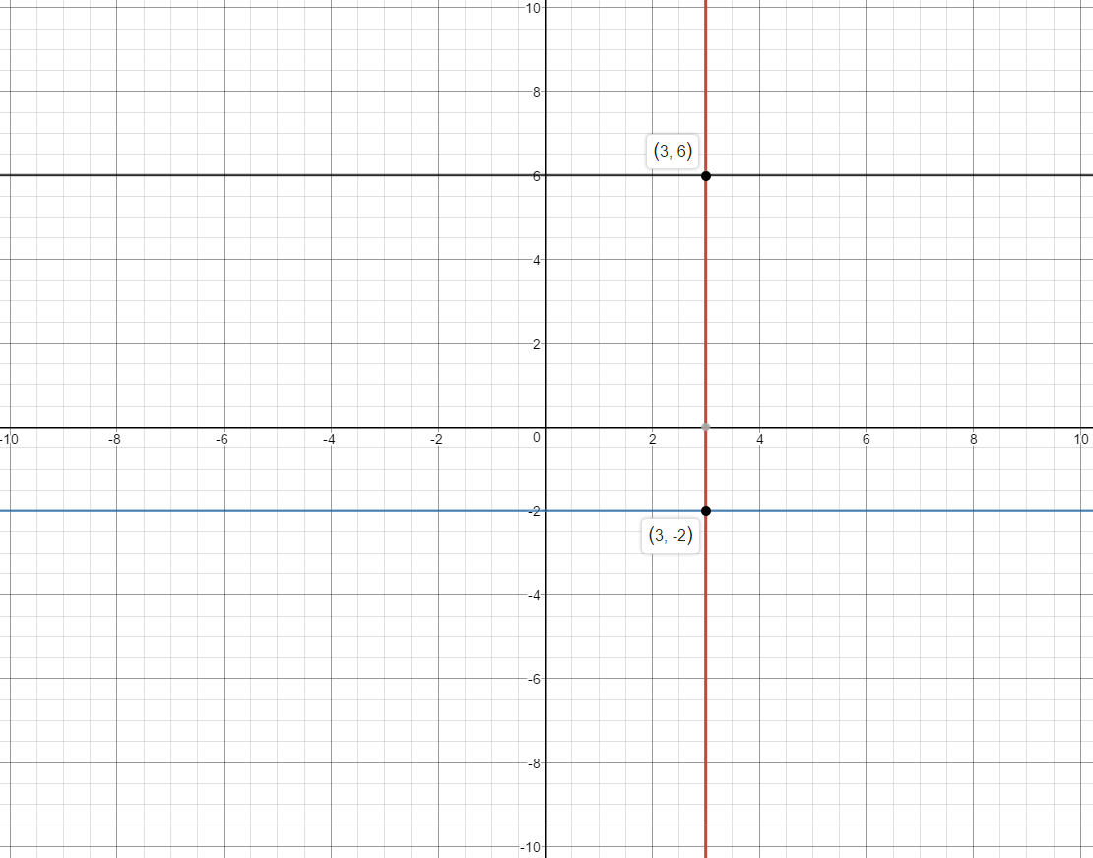
Skill Q1

Slide 3
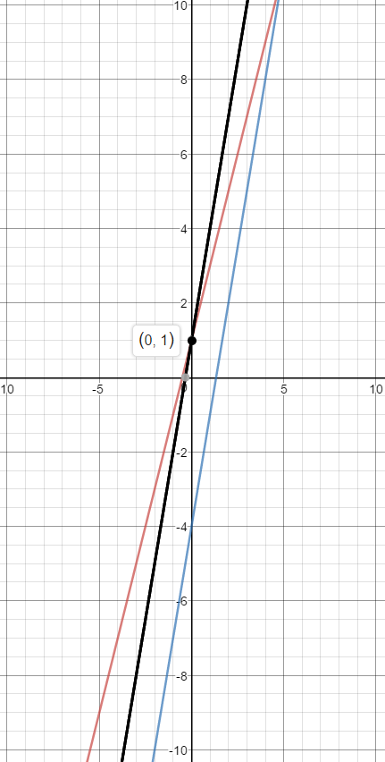
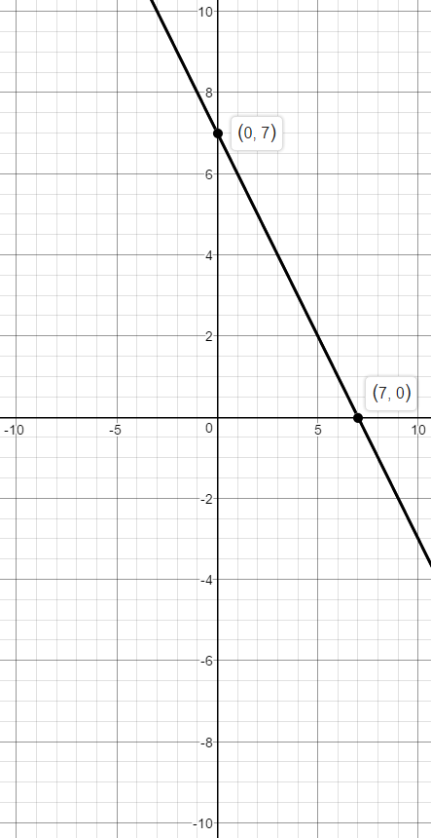
Skill Q2
Skill Q3

Slide 4
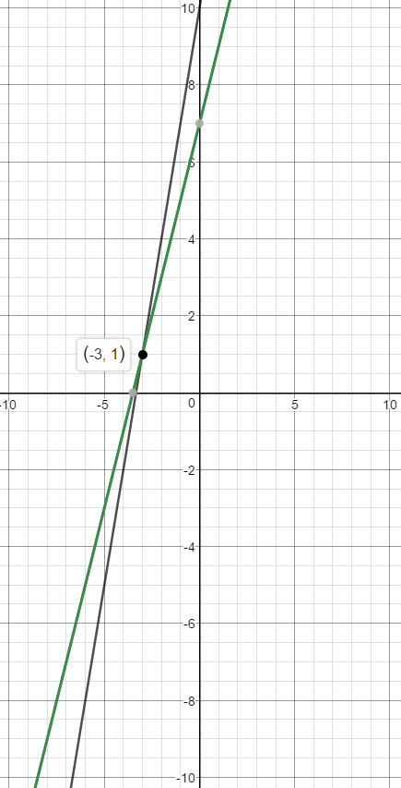
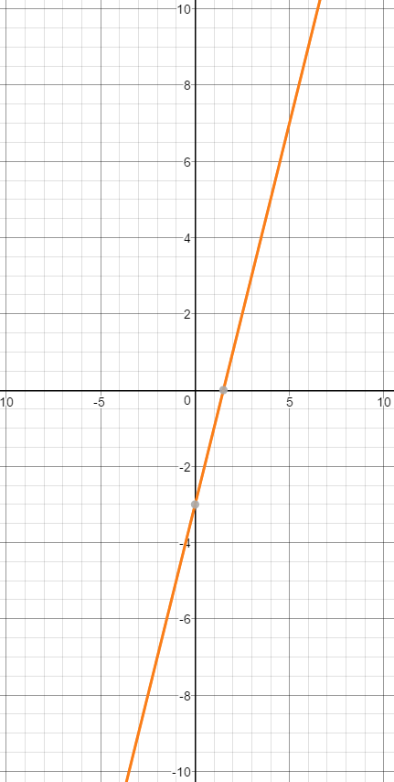
Stretch Q1
Stretch Q2
Any Parallel Line drawn
Equation must be
y=2x+c where c is their intercept.

