Slide 1
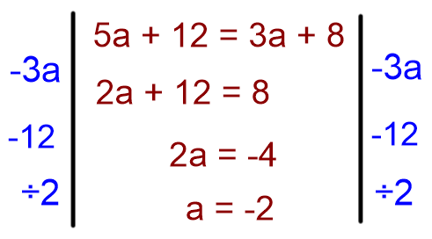
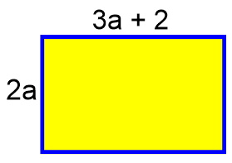
Literacy
Research
Memory
Un-jumble the following keywords
Find out 3 interesting things about the equals sign and where it came from.
Communication is the most important part! Solving equations should look like this:
Loves
In a quote
Ran lie
Know nun
Acne lab
Skill Practice
1) Solve following equations. Show each step clearly.
Stretch!
7c + 10 = 38
5a + 1 = 36
20 = 5c + 10
4p + 8 = 10
4y – 6 = 2y + 5
23 – 3m = 5m + 7
The perimeter of the shape below is 34cm.
Write down an equation.
Solve your equation to work out the value of a.
2) Solve these equations, showing each step clearly.
10a – 3 = 2(4a + 5)
5(2b + 3) = 2b + 9
5(3k + 3) = 5(4k – 4)
3(8j – 10) = 5(7j + 5)

