Slide 1
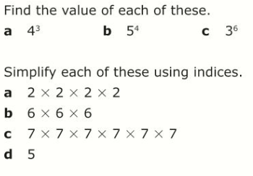
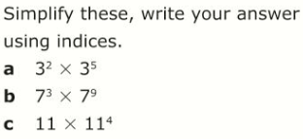
Literacy
Research
Memory
Indices
Standard form
Power
Base Number
Research the population of the UK. Give your answer in standard form
Learn these rules:
When multiplying numbers in index form that have the same base number, you add the powers
When dividing numbers in index form that have the same base number, you subtract the powers
Skill Practice
1.
Stretch!
2.
Write these numbers in full:
3.
Write these numbers in standard form:

