Slide 1
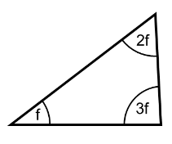
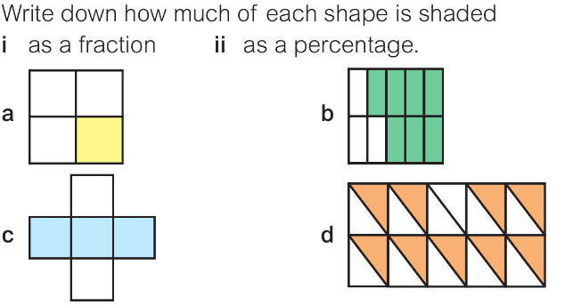
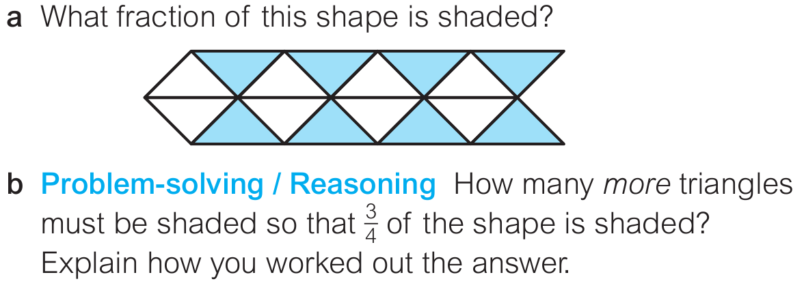
Decimals and Percentages homework
Literacy
What does ‘numerator’ mean?
What does ‘denominator’ mean?
Research
Find an example of decimals, percentages and fractions in real life and write about it here:
Bonus house points for anyone emailing a picture of what you have found.
Memory
What is the value of ‘f’?
Skill practice
Complete the table below:
Stretch: (extension)
Try this section, but don’t worry if you can’t finish it.
Fraction
Decimal
Percentage
1
4
0.3333…
0.05
1
8
12.5%
0.8
150%

