Slide 1
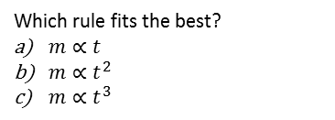
Direct & Inverse proportion
Literacy
Research
Memory
∝ is a symbol that is short for ‘is proportional to’.
Write down the longer meanings to 5 other mathematical symbols.
If the circumference of a circle is directly proportional to the diameter. What is the constant of proportionality?
Who were the first people to use this constant?
If a is directly proportional to b then
a ∝ b
a = kb
For some constant k
If x is inversely proportional to y then
x ∝ 1/y
x = c/y
For some constant c
Skills Practice
Stretch
P is directly proportional to Q. When P is 5, Q is 15. Write a formula for P in terms of Q.
If P is 7, what is Q?
If Q is 10, what is P?
The number of friends (F) at a party, is inversely proportional to the number of slices of cake (S) each receives. 12 Friends are there and they get 4 slices each. Write a formula for F in terms of S.
If only 8 friends turn up, how many slices do they get each?
If 10 friends turn up, how many slices do they get each?
In an experiment, the mass (m) of a mammal was taken after a time (t) that it was born: 1 week, 5 weeks and 15 weeks.
The results are shown in the table.
t | 1 | 5 | 15
m | 1.65 | 43 | 381
7. Match the proportions to the graphs..
$y∝x$
$y∝1/{x^{2}}$
$y∝\sqrt{x}$
y
y
y
Which rule fits the best?
$m∝t$
$m∝t^{2}$
$m{∝t}^{3}$
x
x
x

