Slide 1
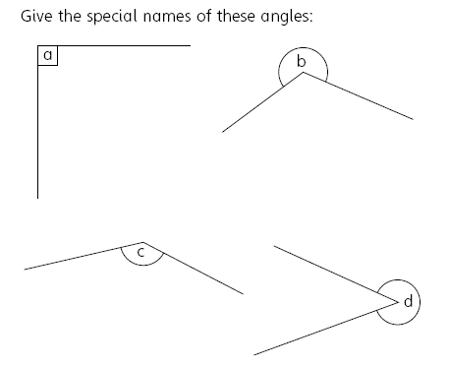
Literacy
Research
Memory
Acute Obtuse Reflex Straight
Right angle
Look for the different angles that are in your home. Record what you find.
Right angle = 90°
Angles on a straight line = 180°
Angles round a point = 360°
Skill Practice
Stretch!
Work out the missing angles
Work out the missing angles

