Slide 1
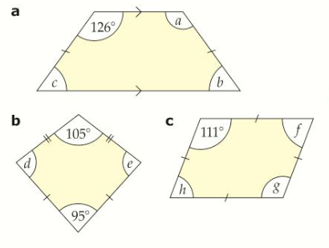
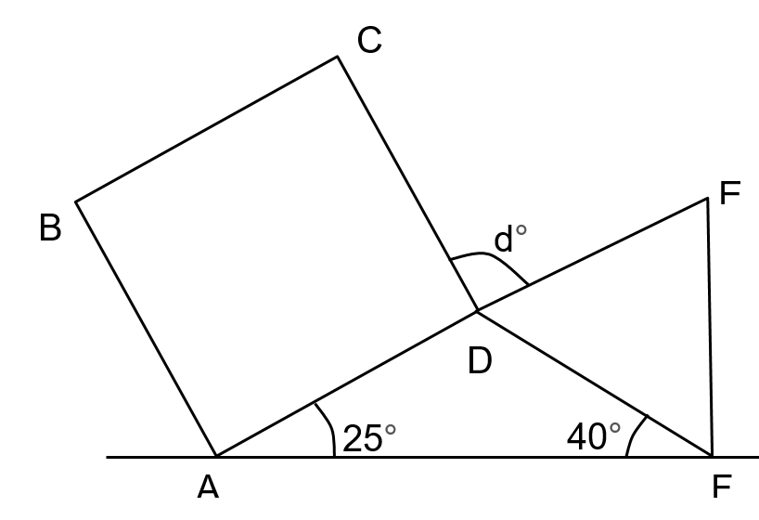

Angles and Shapes
Literacy
Research
Memory
Define the 4 types of triangles
Define a quadrilateral
Angles on a inside a triangle add up to make ${180}^{0}.$
Angles on a inside a quadrilateral add up to make ${360}^{0}.$
Why do angles inside triangles add up to make ${180}^{o}?$
Skill
Stretch
$ABCD$ is a square. $DEF$ is an equilateral triangle. Work out the size of the angle labelled $d°$.
$${78}^{o}$$
$${84}^{o}$$
$${35}^{o}$$
b
c
$${63}^{o}$$
$${37}^{o}$$
a
$${42}^{o}$$
d

