Slide 1
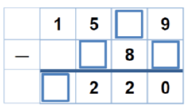
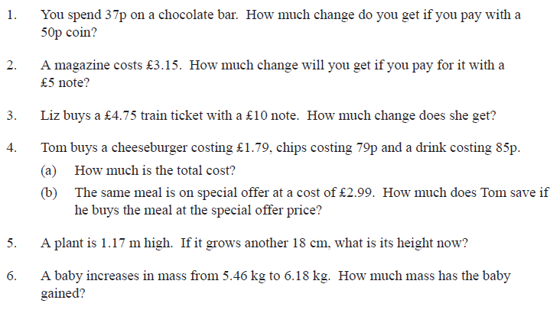
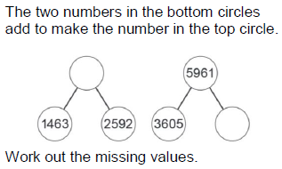
Literacy
Research
Memory
Addition words
Subtraction words
Find words that are associated with addition and subtraction. Write them in the correct place in the Literacy box.
Write down all of the addition/subtraction facts to ten from memory.
For example, 1+9=10
10-9=1.
Write them in a suitable order
Skill Practice
Stretch!
Work out the
missing numbers
You must use written column methods for each one.

